Slide 2
What I did
Why I did it

Slide 3
2018-present
Nichols et al. (in prep) Roots as drivers of the rotation effect in maize?
Nichols et al. (in prep) Using models to unravel causal mechanisms of the continuous maize penalty
Nichols & MacKenzie (in prep) Decision analysis to target cover crop research priorities in Central Iowa
Nichols et al. (in review) Winter cover cropping effects on soil water storage vary by site: Field measurements and a proposed causal model
Nichols et al. (2020). Effect of long-term cover-cropping on weed seedbanks. Frontiers in Agronomy
Nichols et al. (2020) Cover crops and weed suppression in the U.S. Midwest: A meta‐analysis and modeling study. Agricultural and Environmental Letters
Weisberger*, Nichols *, Liebman (2019) Does diversifying crop rotations suppress weeds? A meta-analysis. PloS one
Nichols et al. (2019) Maize root distributions strongly associated with water tables in Iowa, USA Plant and Soil
Bird, Nichols, et al. (in review). Means, motive, and opportunity: A stakeholder analysis method to understand likelihood of action in food-energy-water systems. Elementa
Pasley, Nichols, et al. (2021). Rotating maize reduces the risk and rate of nitrate leaching. Environmental Research Letters.
Archontoulis, Castellano, Licht, Nichols, et al. (2020) Predicting crop yields and soil-plant nitrogen dynamics in the US Corn Belt. Crop Science
Liebman & Nichols (2020) Cropping system redesign for improved weed management: A modeling approach illustrated with giant ragweed (Ambrosia trifida). Agronomy
Martinez-Feria, Nichols, et al. (2019) Can multi-strategy management stabilize nitrate leaching under increasing rainfall? Environmental Research Letters

Slide 4
Longer rotations may benefit corn roots
Rotating corn reduces the risk of nitrate leaching
Cropping systems with more variation in planting dates have less weeds
Cover crops can effectively complement herbicides
(Cover crop termination – corn planting) window is where producers are exposed to the most risk

Slide 5
Longer rotations may benefit corn roots
Rotating corn reduces the risk of nitrate leaching
Cropping systems with more variation in planting dates have less weeds
Cover crops can effectively complement herbicides
(Cover crop termination – corn planting) window is where producers are exposed to the most risk

Slide 8
Rotation vs mono

Slide 9


Slide 10
Agronomist (noun):
A person who is continuously fascinated by how corn responds to nitrogen

Slide 11
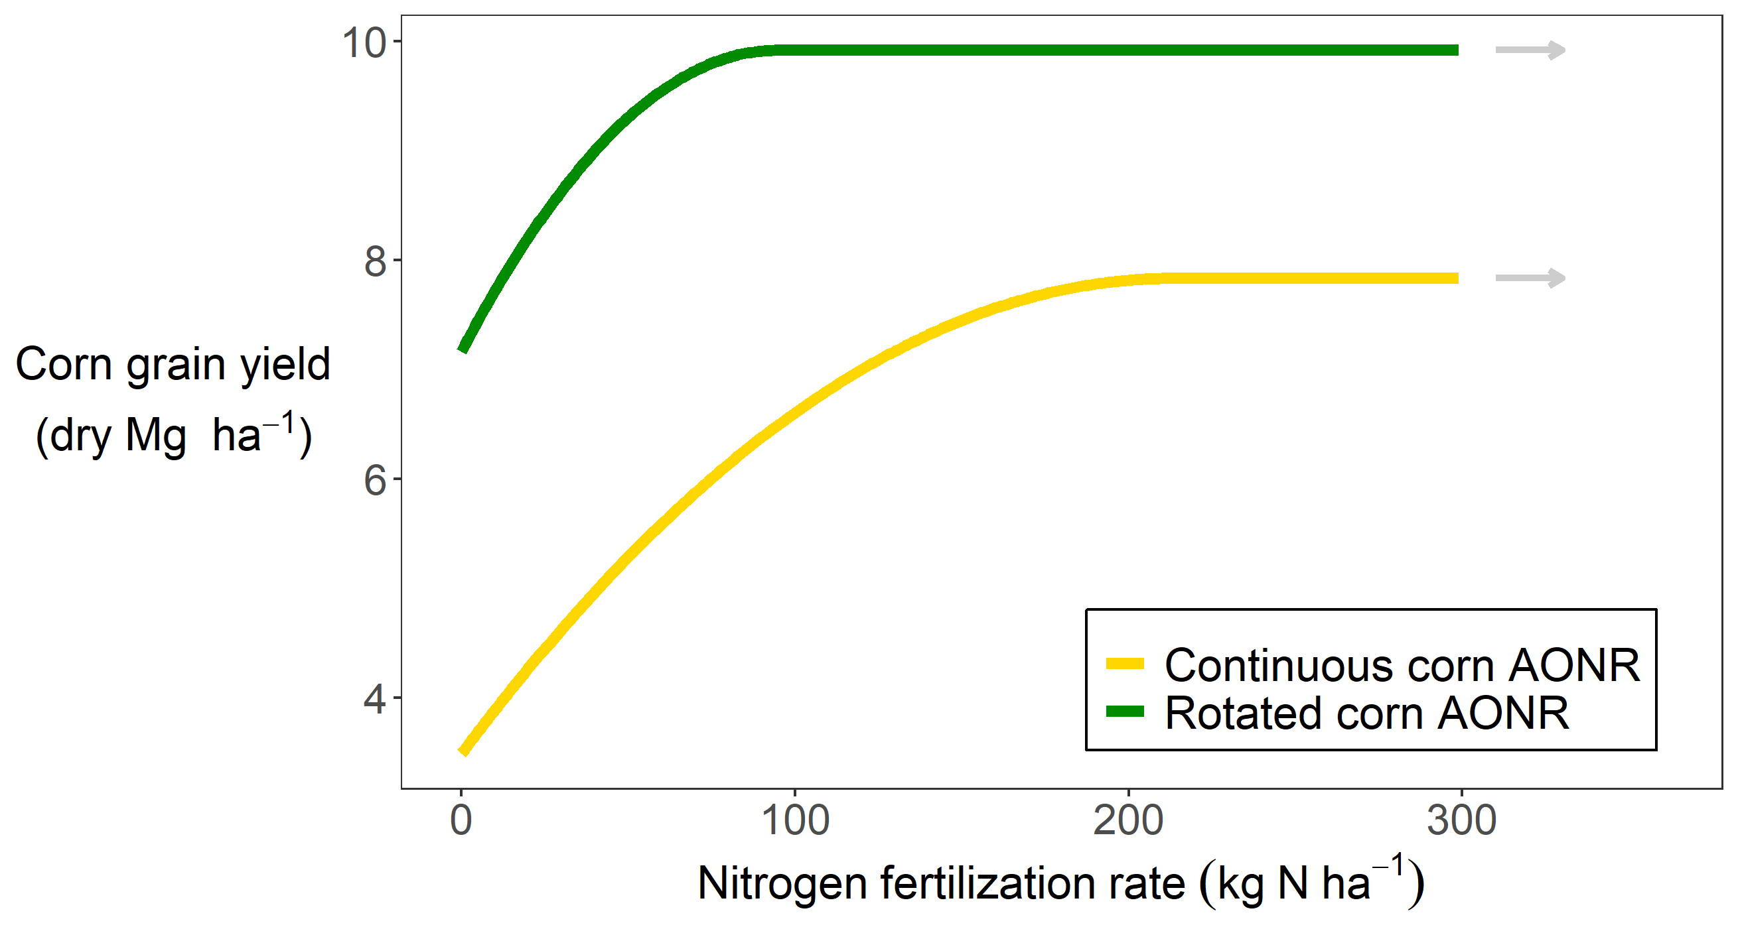

Slide 13
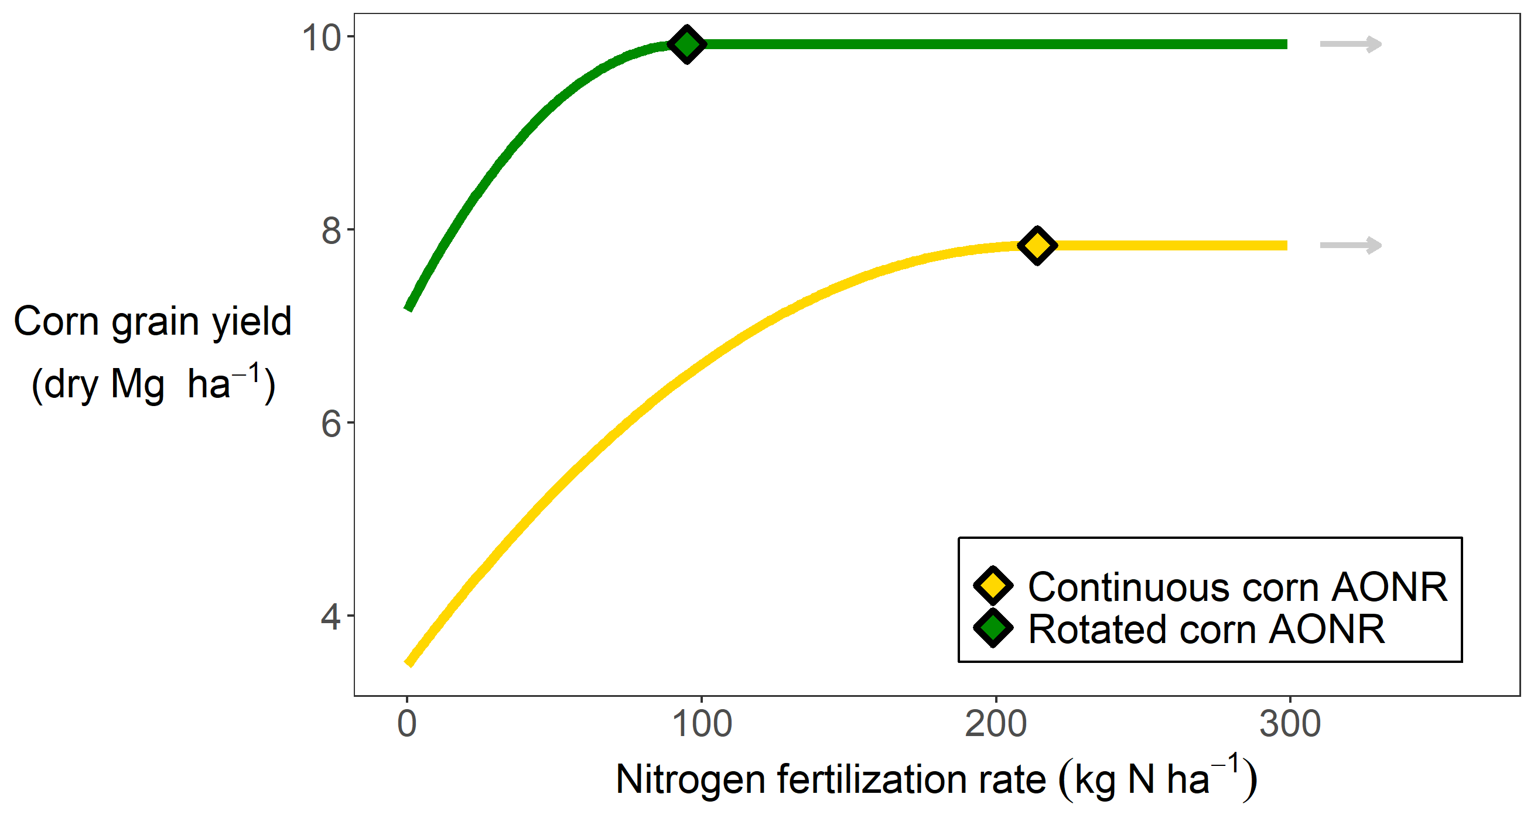

Slide 14
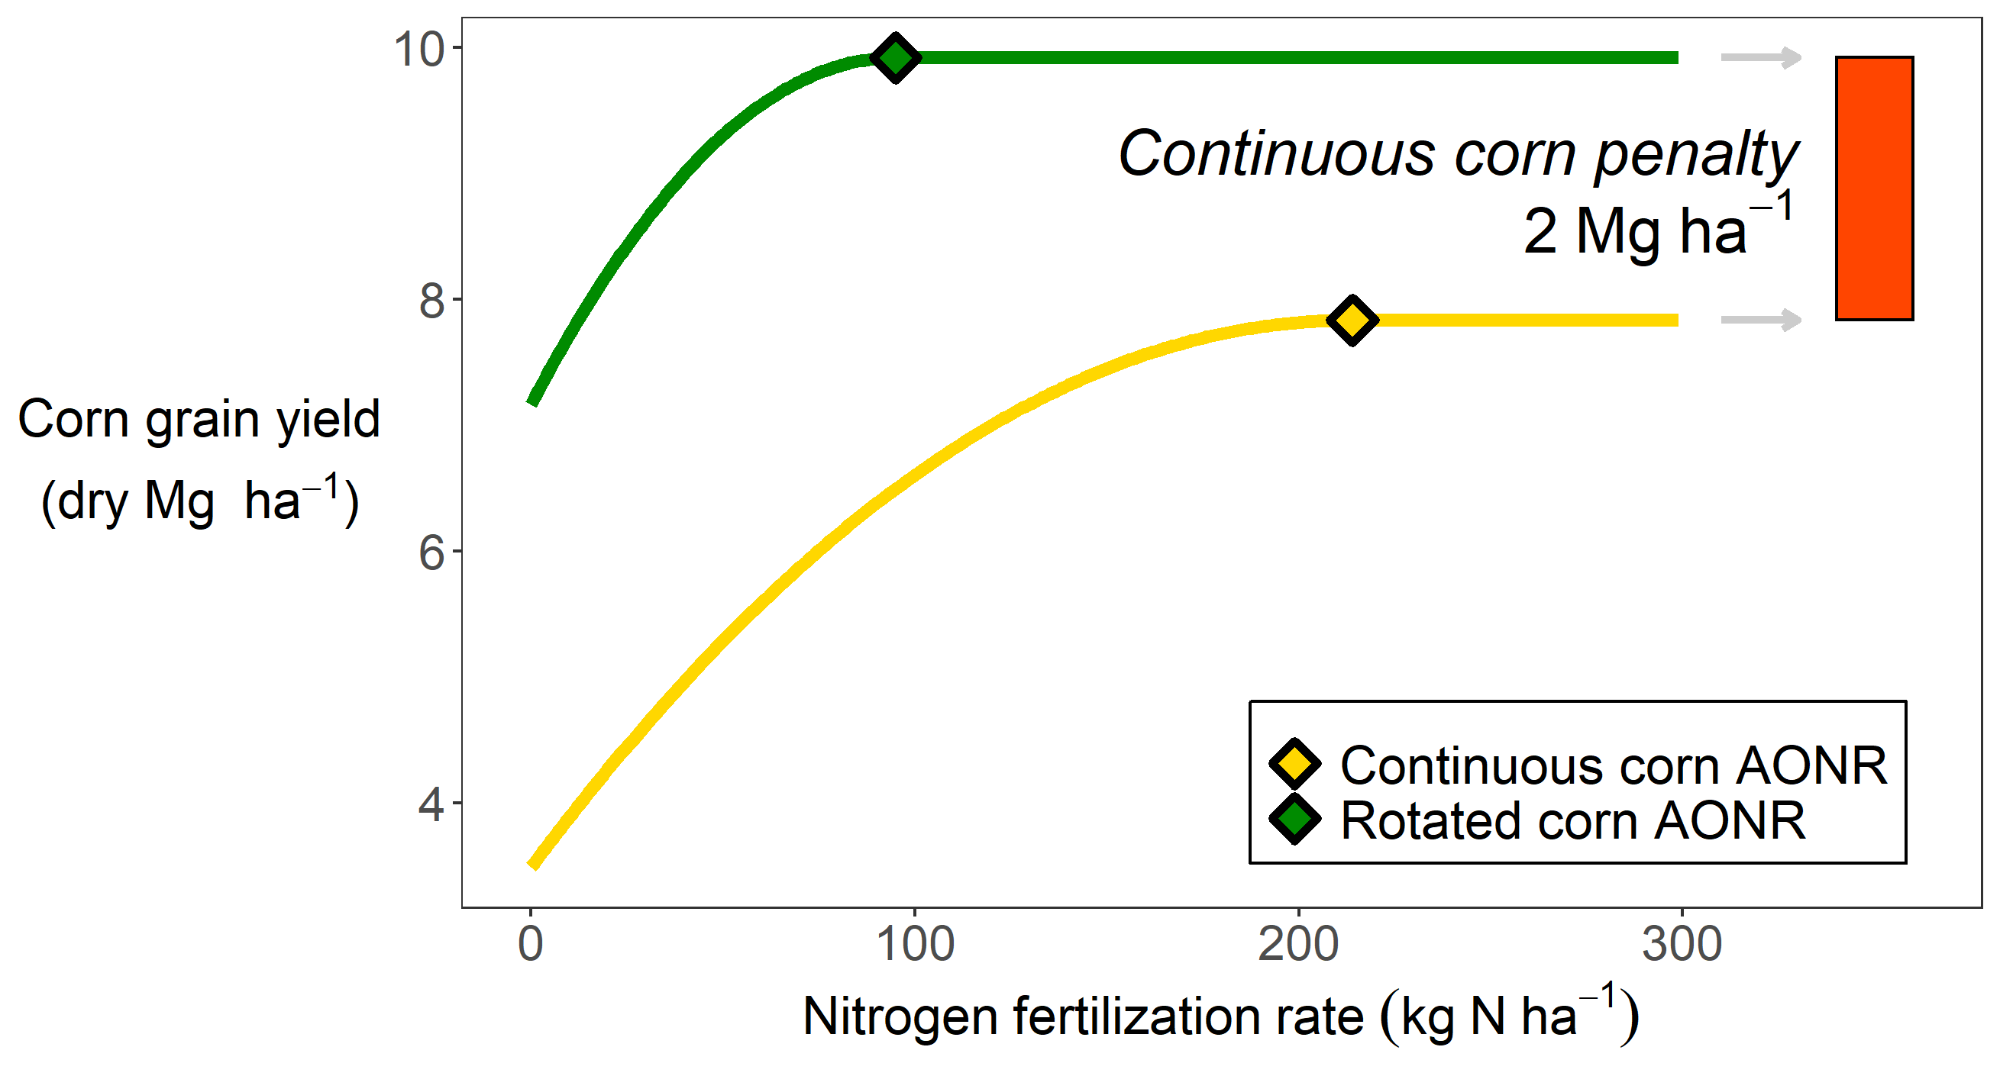

Slide 15
Cont corn map

Slide 17
Approach schematic (lit, map of sites, apsim)

Slide 18
Map of sites

Slide 19
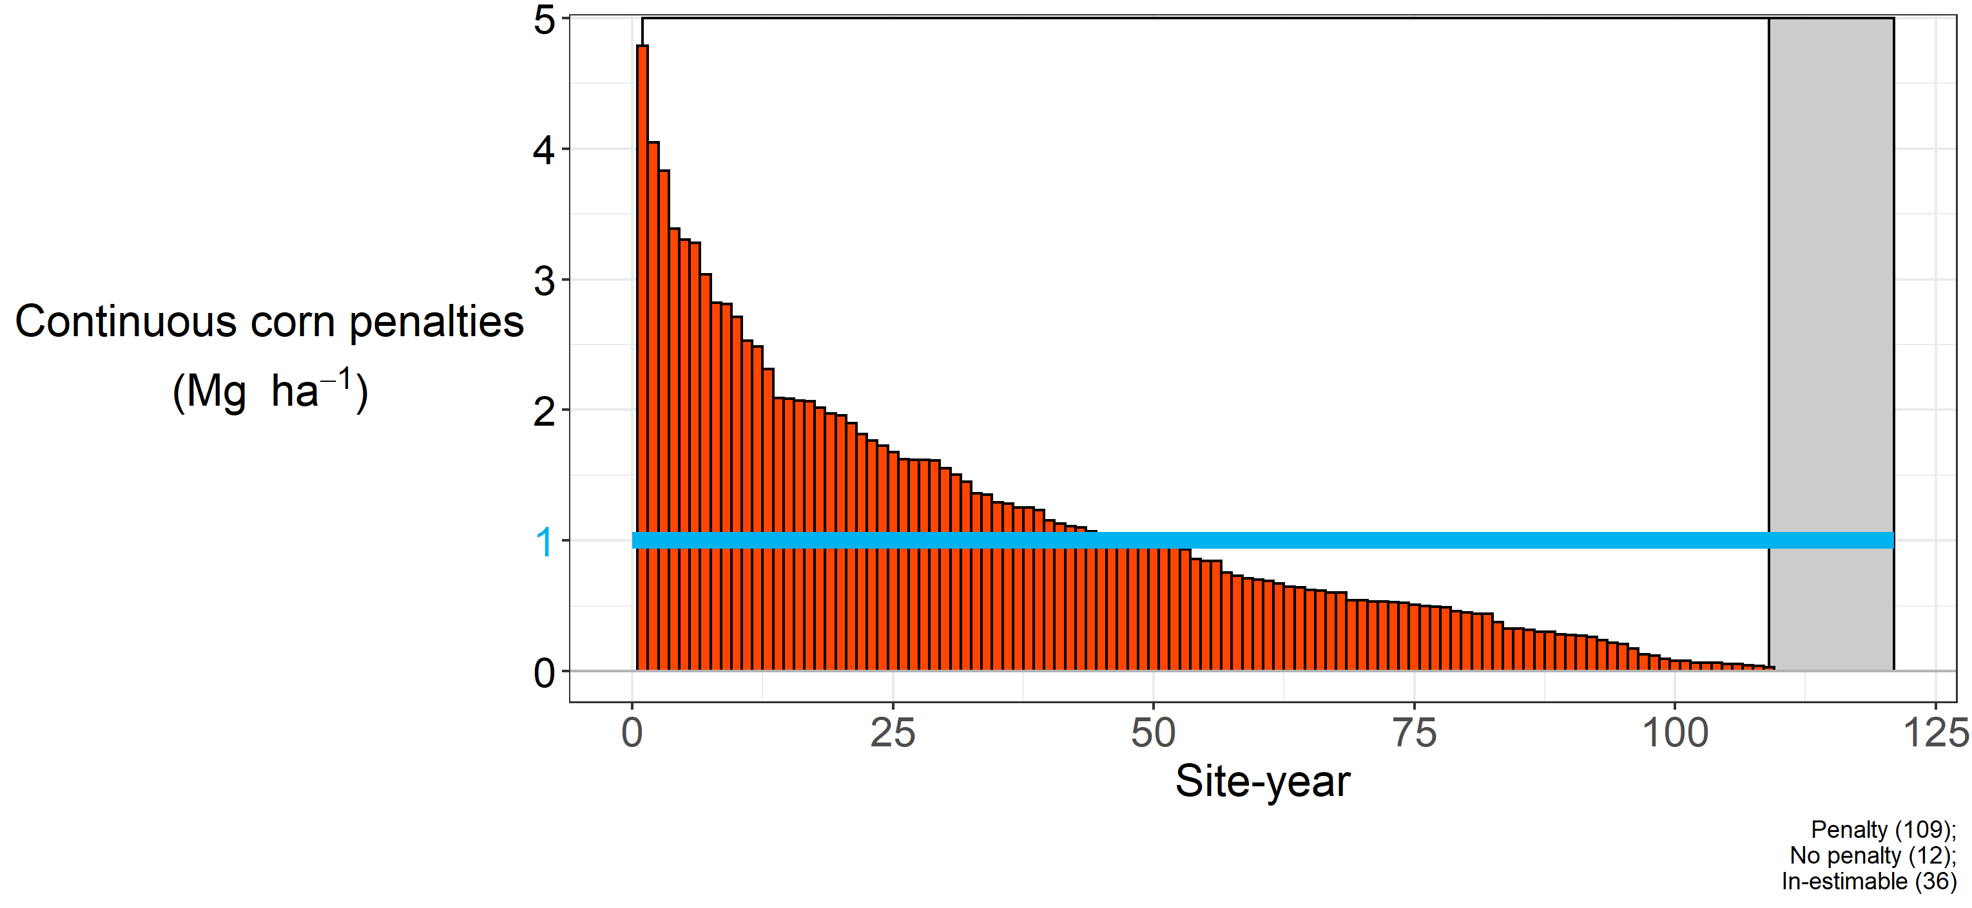
90% of site-years had a penalty at sufficient N

Slide 20
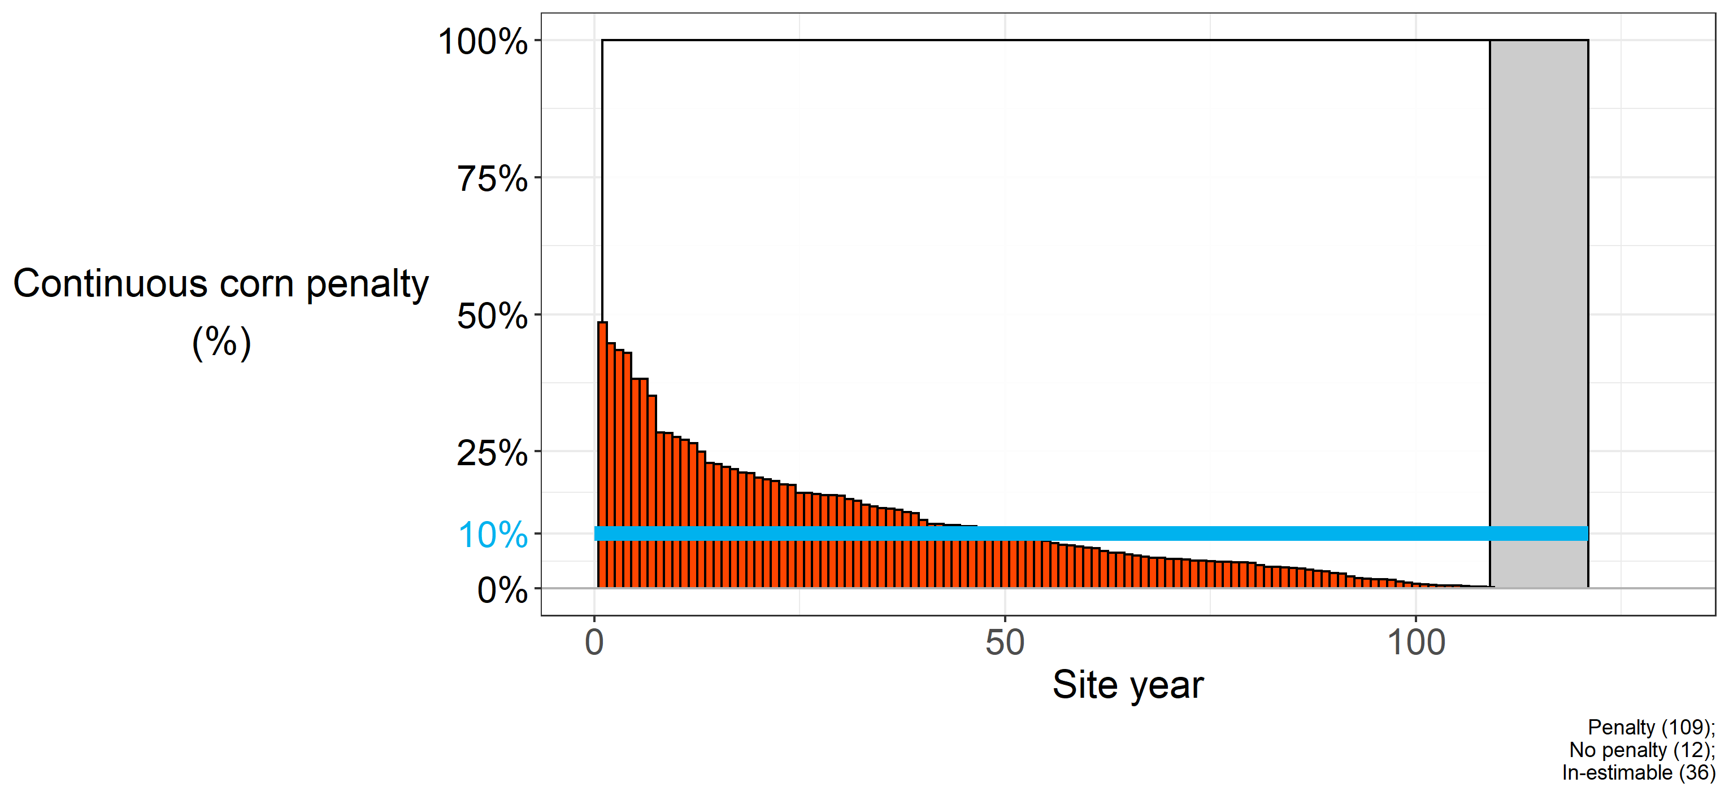
Continuous corn penalty ~10% (0-50%)

Slide 21
Table of hypotheses

Slide 22
Translated to apsim

Slide 23
Results

Slide 24
Extende from rotation even fruther

Slide 25
Suite of field msmts

Slide 27
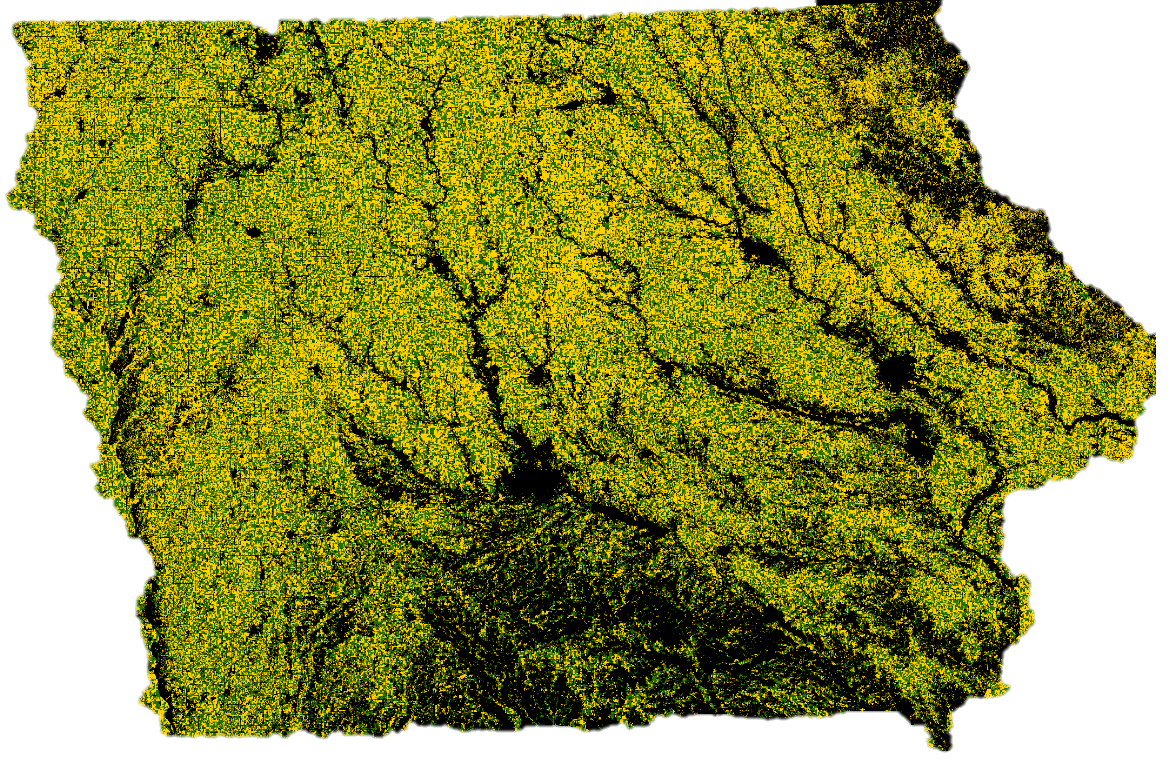
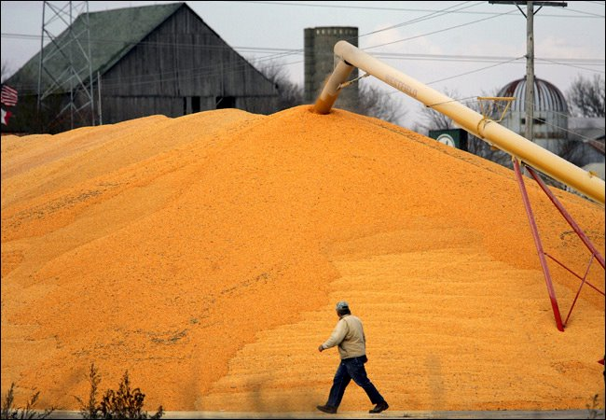

Slide 28




Slide 29
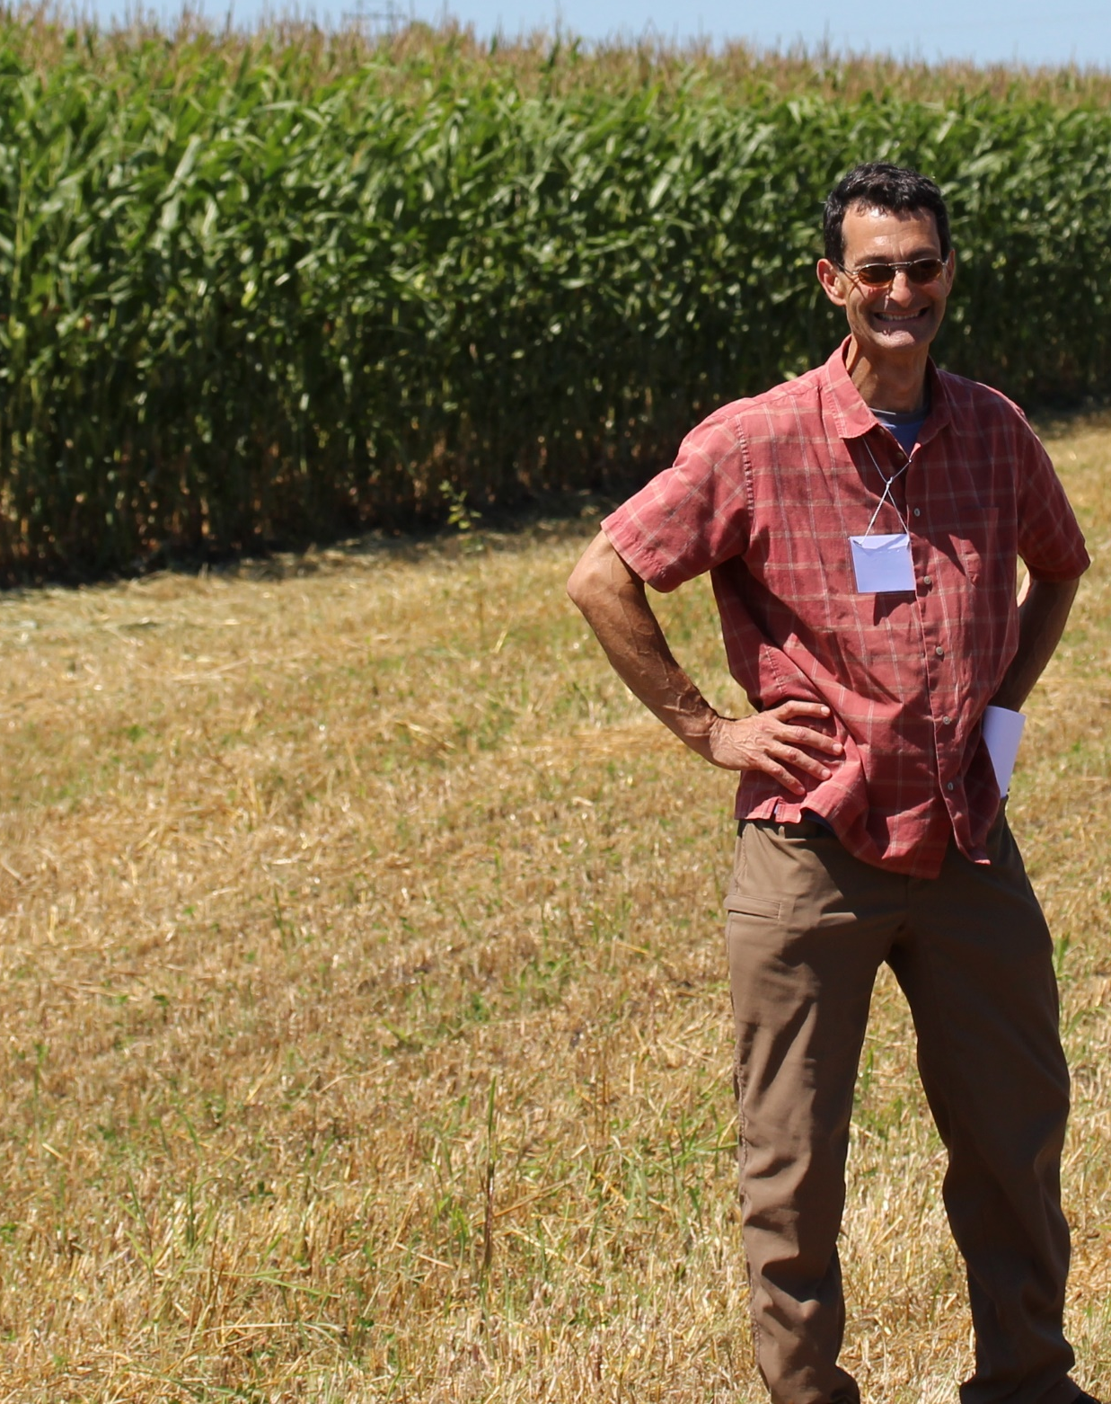

Slide 30
Extras

Slide 31
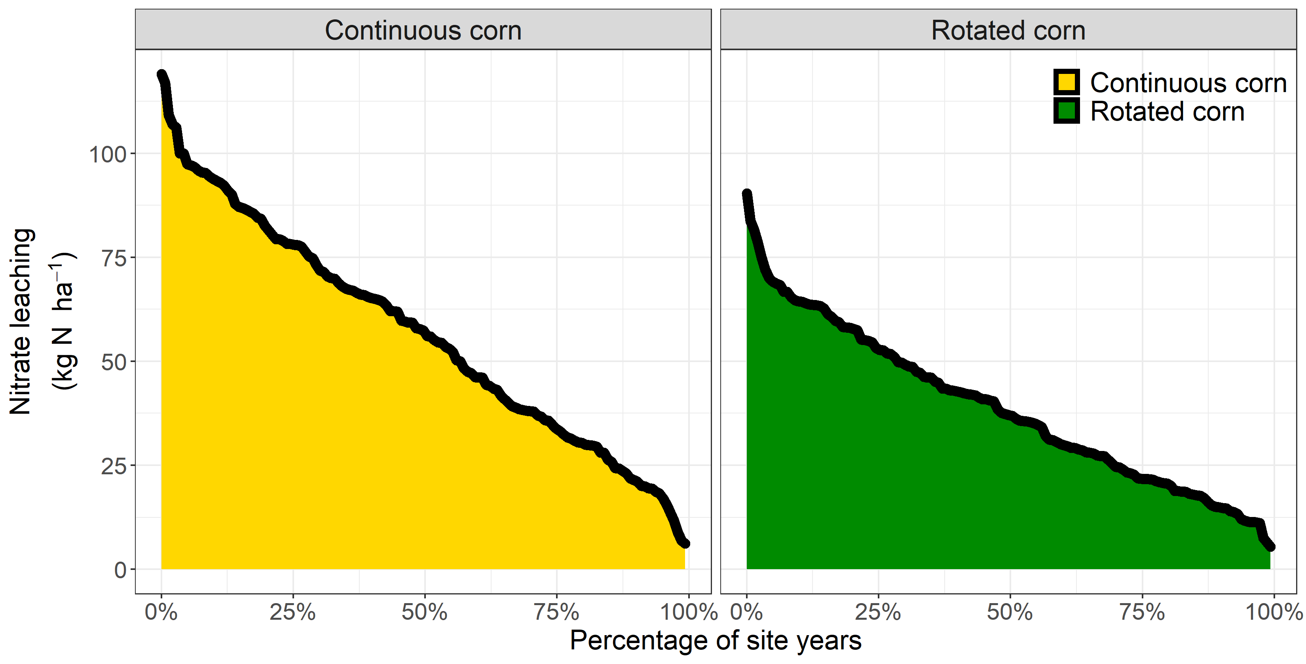
8 sites, 151 site-years, modeled nitrate leaching at 150 and 200 kg N application

Slide 32
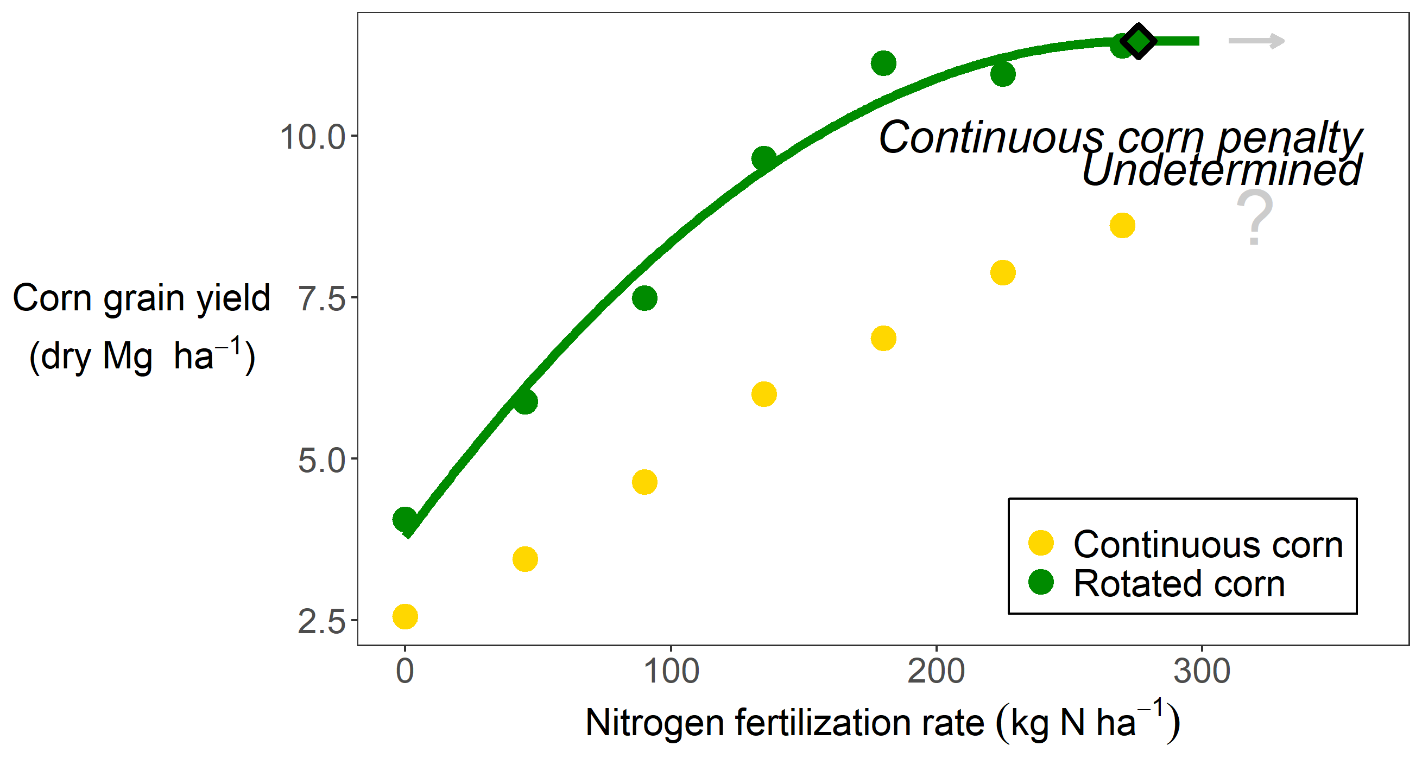
Example of undetermined penalty

Slide 33
